Slide 1
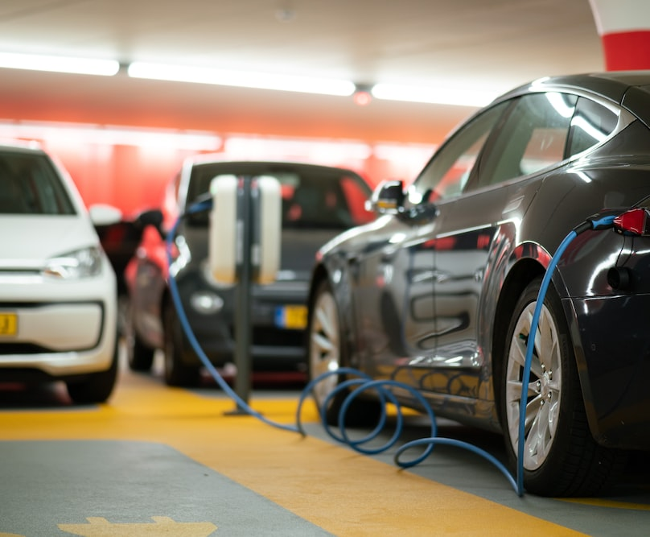




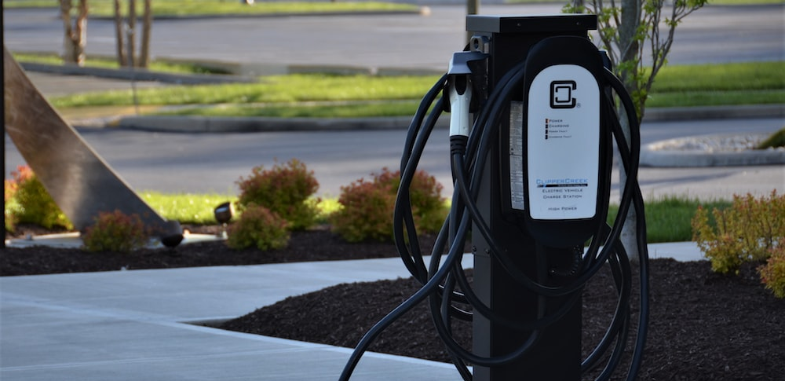
UTC-7SPC Meeting
EV Charging Datasets and Potential Projects

Slide 2
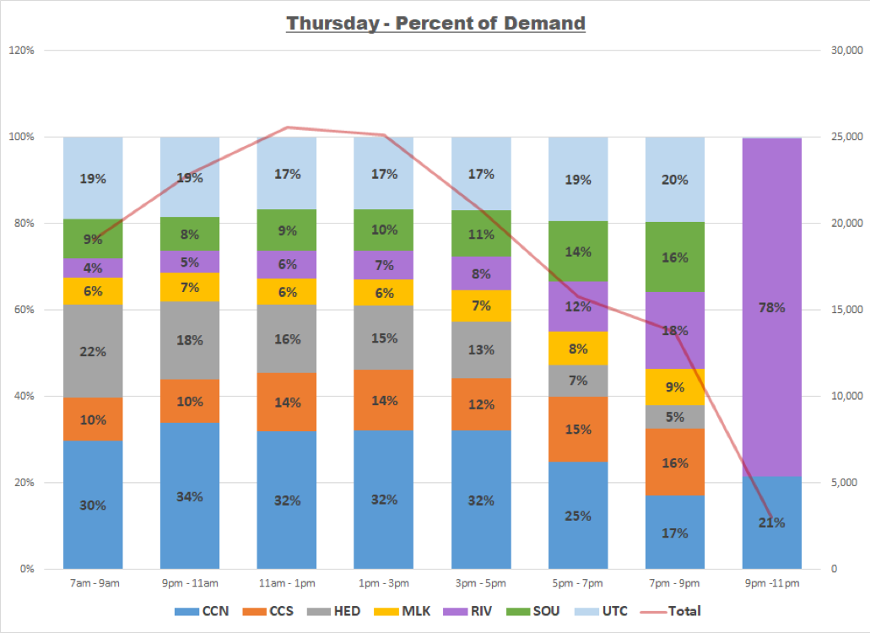
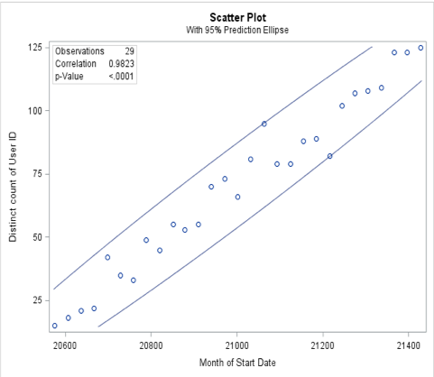
Priority 1
Problem 1 - How to measure the viability of Level 2 and DC fast charging sites in 5 years (after grant funding, which sites will be worth investing in to keep running)
Approach – Individual EV and general utilizations will be the most important metric to consider.
Prior Projects – We have done a similar study mostly focused on demand forecast using EV charging data from CARTA* from various points of view:
Number of charging events
Number of unique EVs
Energy demands
*Chattanooga Area Reginal Transportation Authority

Slide 3
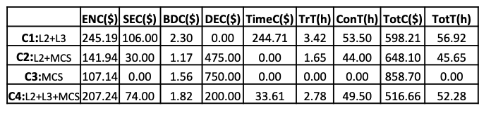
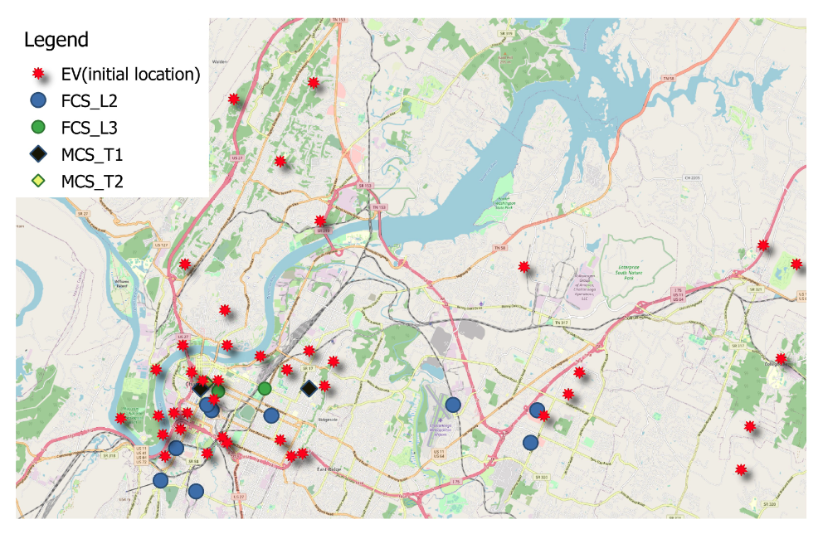
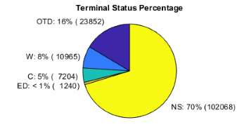
Priority 2
Problem 2 - What is the optimal power per port ratio in Urban vs Rural vs Interstate locations? When does adding more power to a site have diminishing returns?
Approach – Identifying both obvious and hidden demands for different power rates. Run optimization to define the best ratios.
Obvious demand is the actual demand that has been recorded in data
Hidden demand or demand not met is the one that has not been met because the EV user has not been able to find a charging dtation
Metrics – Location, utilization of charging stations, average parking and charging times, number of events, types of cars visiting.

Slide 4
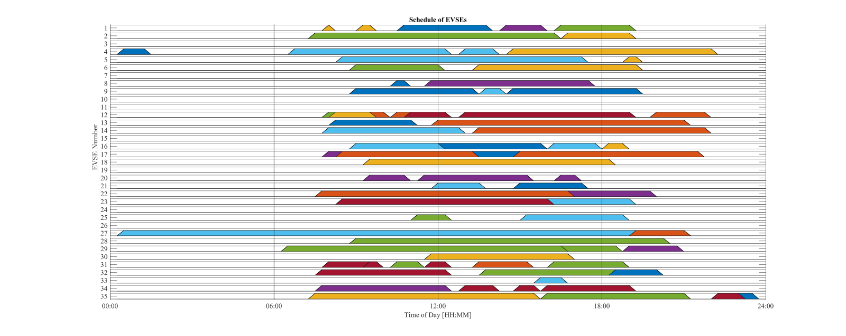
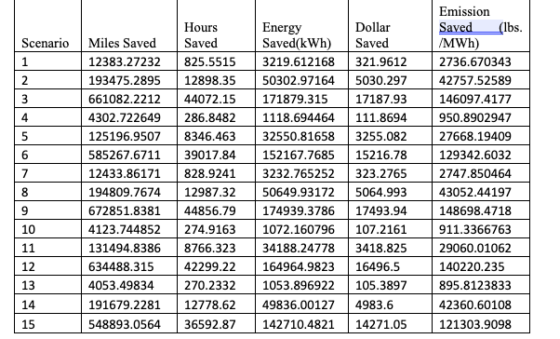
Priority 3
Problem 4 - Tools for measuring/reporting location based GHG savings based on Valley generation mix (not national averages)
Approach – Crossing charging event data with the generation mix data and studying the GHG saving.
Using power flow analysis approaches, we will define the marginal impacts of each charging station and study the GHG impact.
Prior projects – Multiple power flow analysis and optimization projects. GHG impact studies using CARTA data.
Studied the impact of optimal scheduling on different operation parameters including GHG emmissions

Slide 5

Questions and Discussions

